Slide 1
Randomized Algorithms CS648
Lecture 4
Algebraic Techniques
Fingerprinting Techniques
Frievald’s Technique

Slide 2
Fingerprinting technique
Application
Checking equality of files

Slide 3



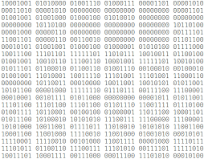

Fingerprinting
Fingerprints don’t capture the complete information of a person. Still fingerprinting is used and it works well in practice. What is the reason ?
Reason: The aim is to be able to distinguish two different persons. For this purpose finger prints suffice since every two human beings (even twins) have distinct finger prints.
Applications : Cryptography

Slide 4





Aim: To determine if File A is identical to File B by communicating fewest bits ?
Network
File A
File B
size(A) = $n$ bits
size(B) = $n$ bits
 | No. of bits to be sent
Deterministic algorithm
$$n$$
Randomized algorithm
O(log($n$))

Slide 5






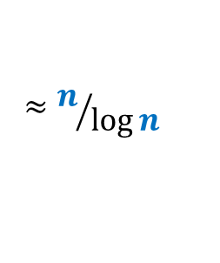

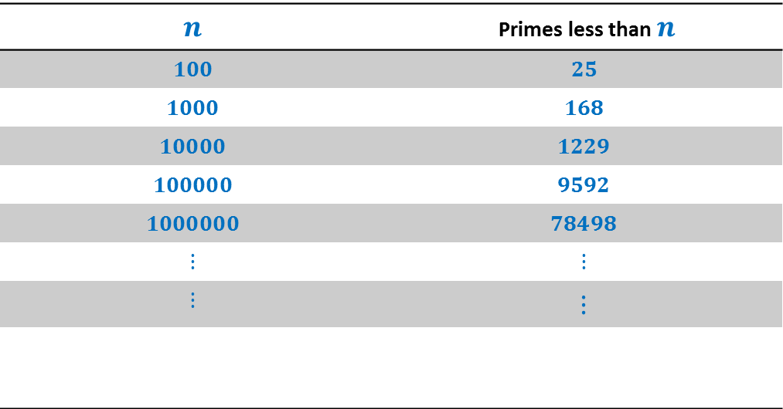


How many primes less than $n$ ?
$$n$$ | Primes less than $n$
$$100$$ | $$25$$
$$1000$$ | $$168$$
$$10000$$ | $$1229$$
$$100000$$ | $$9592$$
$$1000000$$ | $$78498$$
$$⋮$$ | $$⋮$$
$$⋮$$ | $$⋮$$
$π\left(n\right)$:
$$π\left(n\right)$$
$$≈n/{\log{n}}$$
Interestingly this simple fact alone will be used in devising the algorithm.
Huge gap
How many prime factors of $n$ ?
$$<\log{n}$$
$$=$$
$$2^{2}∙5^{3}∙7$$
$$3500$$
$$2^{2}∙5^{3}∙7$$
Notes:
Randomization will exploit this huge difference to achieve a very simple and elegant algorithm.

Slide 6
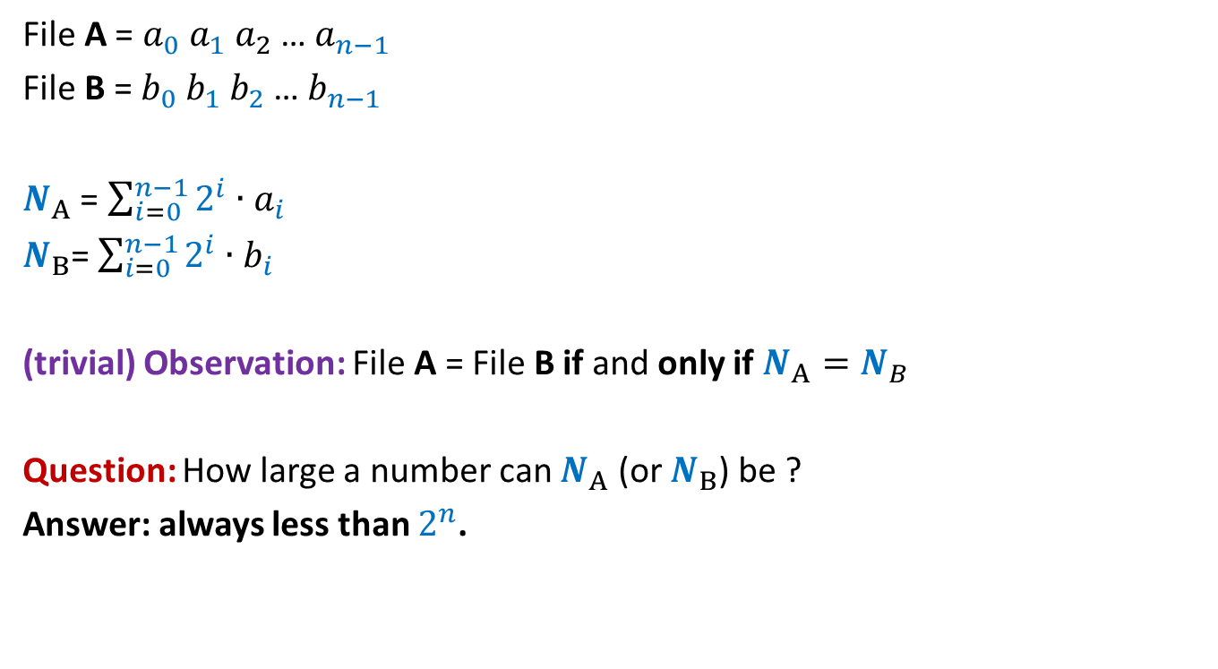
Key idea: Visualize a file as a binary number
File A = $a_{0} a_{1} a_{2}$… $a_{n−1}$
File B = $b_{0} b_{1} b_{2}$… $b_{n−1}$
$N_{A}$ = $\sum_{i=0}^{n−1}{2^{i}∙a_{i}}$
$N_{B}$= $\sum_{i=0}^{n−1}{2^{i}∙b_{i}}$
(trivial) Observation: File A = File B if and only if $N_{A}=N_{B}$
Question: How large a number can $N_{A}$ (or $N_{B}$) be ?
Answer: always less than $2^{n}$.

Slide 7

Network
File A
File B
size(A) = $n$ bits
size(B) = $n$ bits
What should be ?

Slide 8
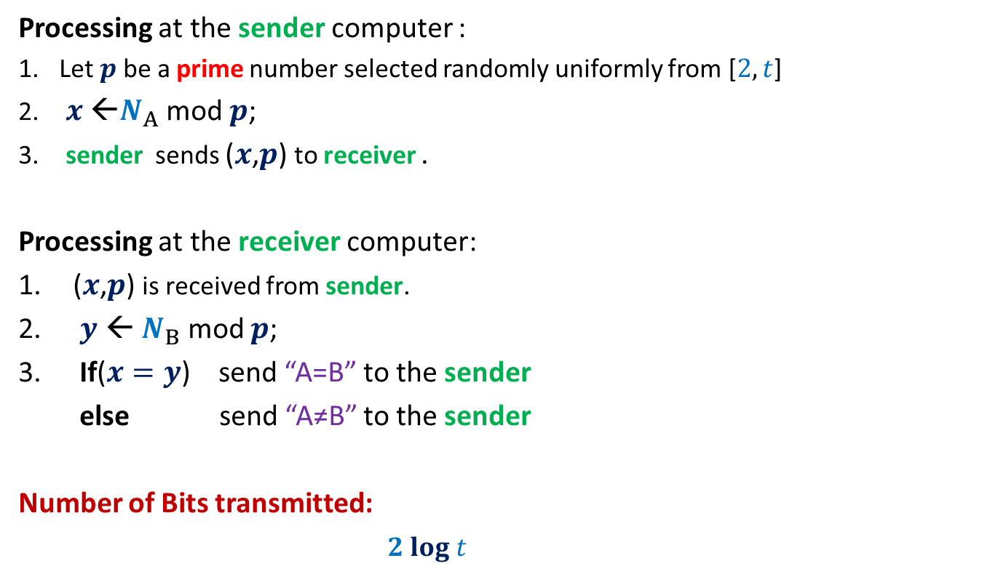
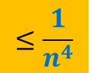
RandomEqualityChecking-Protocol($A$,$B$)
Processing at the sender computer :
Let $p$be a prime number selected randomly uniformly from [$2,t$]
$x$ ←$N_{A}$ mod $p$;
sender sends ($x$,$p$) to receiver .
Processing at the receiver computer:
($x$,$p$) is received from sender.
$y$ ← $N_{B}$ mod $p$;
If($x=y$) send “A=B” to the sender
else send “A≠B” to the sender
Number of Bits transmitted:
$2 log t$

Slide 9






Error Analysis
Cases
Let $d$ = $|N_{A}− N_{B}|$
Observation: If $N_{A}≠N_{B}$, then surely $d>0$.
The protocol makes an error if and only if
$N_{A} mod p=N_{B} mod p$
$N_{A} mod p−N_{B} mod p=0$
($N_{A} −N_{B}$) $mod p$ $=0$
$p$divides $d$
$$N_{A}=N_{B}$$
$N_{A}mod p=N_{B} mod p$
$$N_{A}mod p=N_{B} mod p$$
$$N_{A}≠N_{B}$$
?
$$with some probability$$

Slide 10






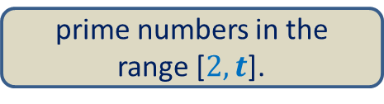





Error Analysis
Cases
$$N_{A}=N_{B}$$
$N_{A}mod p=N_{B} mod p$
$$N_{A}mod p=N_{B} mod p$$
$$N_{A}≠N_{B}$$
?
$$with some probability$$
$$≤\frac{n}{π(t)}$$
$$1$$
$$d$$
$$2^{n}$$
The prime factors of $d$
$$≤n$$
$$1$$
$$t$$
prime numbers in the range [$2,t$].
$$≈\frac{t}{log t }$$
$$π(t)$$

Slide 11

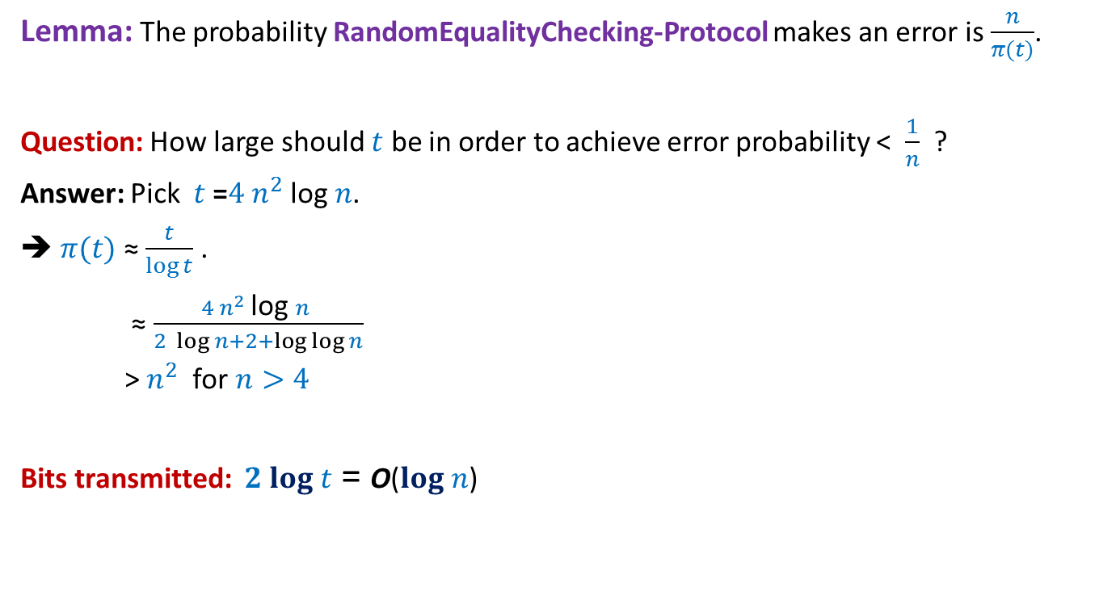
Error Analysis
Lemma: The probability RandomEqualityChecking-Protocol makes an error is $\frac{n}{π(t)}$.
Question: How large should $t$ be in order to achieve error probability < $\frac{1}{n}$ ?
Answer: Pick $t$ =$4 n^{2}$log $n$.
➔ $π(t)$ ≈ $\frac{t}{\log{t}}$ .
≈ $\frac{4 n^{2} \text{log} n }{2 \log{n}+2+\log{\log{n}}}$
> $n^{2}$ for $n>4$
Bits transmitted: $2 log t$ = O($log n$)
$$≈\frac{t}{log t }$$
$$π(t)$$

Slide 12
Frievald’s technique
Application : Matrix Product verification

Slide 13

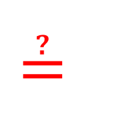




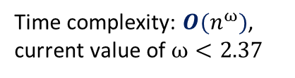


Frievald’s Algorithm (Rusins Frievald, 1977)
Problem: Given three $n$-by-$n$matrices $A$, $B$, and $C$, determine if $C≟A⨯B$.
Best deterministic algorithm:
$D$ ← $A⨯B$;
Verify if $C=D$ ?
$$1 2 … n$$
$$1$$
2
$$⋮$$
$$n$$
$$≟$$
$$⨯$$
$$C$$
$$A$$
$$B$$
Time complexity: $O(n^{ω})$,
current value of $ω<2.37$
STOC 2012

Slide 14













Frievald’s Algorithm (Rusins Frievald, 1977)
$$1$$
0
$$⋮$$
$$1$$
$$1$$
0
$$⨯$$
$$⨯$$
$$A$$
$$B$$
$$x$$
$$y$$
$$≟$$
$$1$$
0
$$⋮$$
$$1$$
$$1$$
0
$$⨯$$
$$C$$
$$x$$
$$z$$

Slide 15

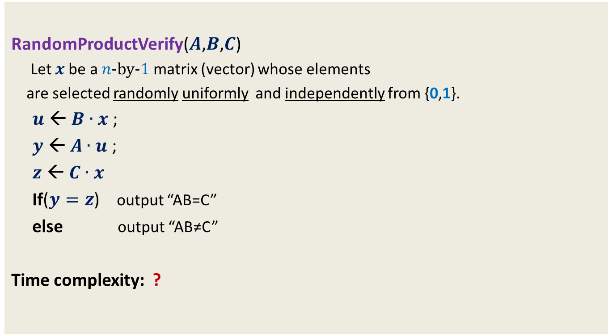
Frievald’s Algorithm (Rusins Frievald, 1977)
RandomProductVerify($A$,$B$,$C$)
Let $x$be a $n$-by-$1$matrix (vector) whose elements
are selected randomly uniformly and independently from {0,1}.
$u$ ← $B∙x$ ;
$y$ ← $A∙u$ ;
$z$ ← $C∙x$
If($y=z$) output “AB=C”
else output “AB≠C”
Time complexity: ?
$$O(n^{2})$$

Slide 16

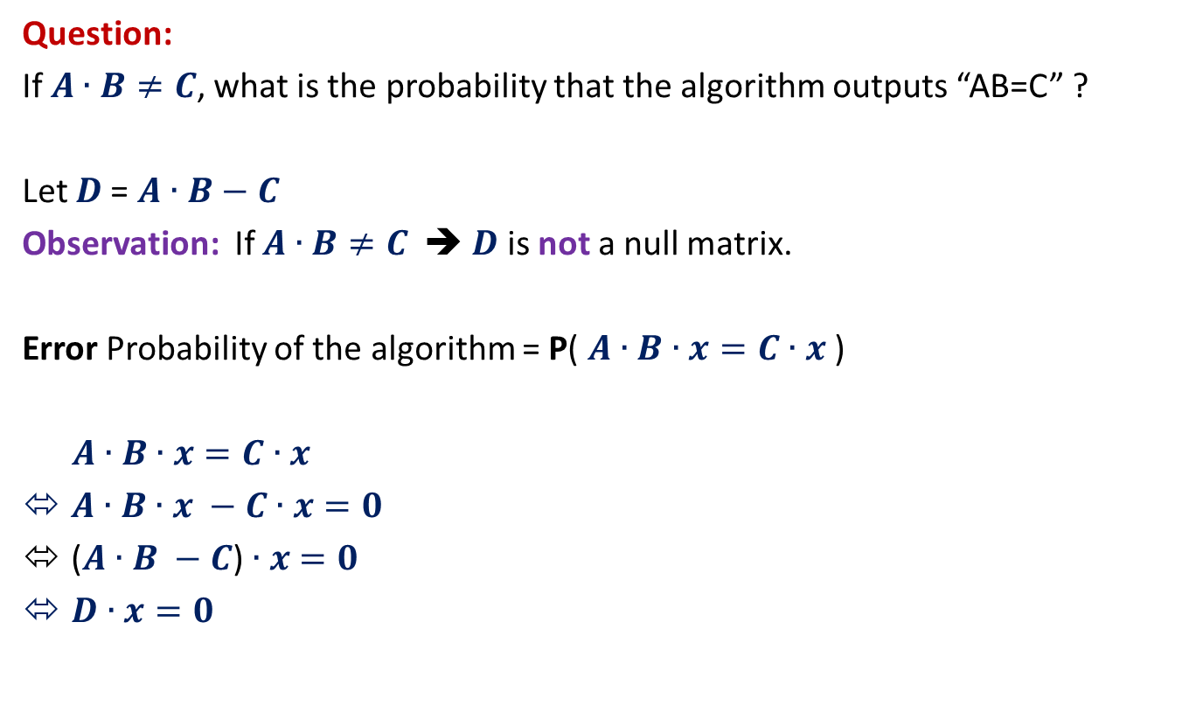
Frievald’s Algorithm (Analyzing error probability)
Question:
If $A∙B≠C$, what is the probability that the algorithm outputs “AB=C” ?
Let $D$= $A∙B−C$
Observation: If $A∙B≠C$ ➔ $D$ is not a null matrix.
Error Probability of the algorithm = P( $A∙B∙x=C∙x$ )
$A∙B∙x=C∙x$
$A∙B∙x −C∙x=0$
($A∙B −C$) $∙x$ $=0$
$D∙x=0$
$$D∙x=0$$
null vector

Slide 17



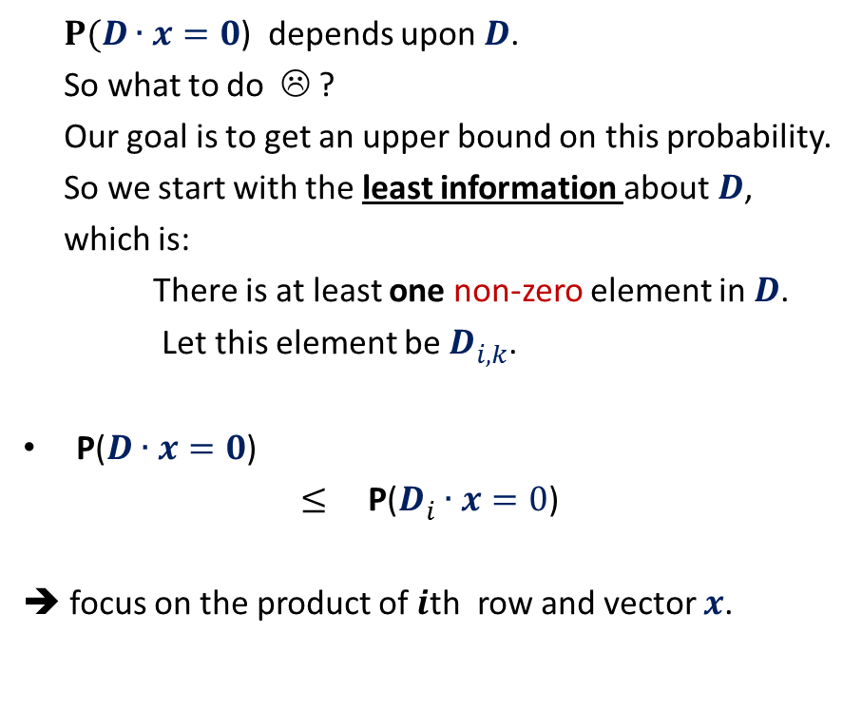

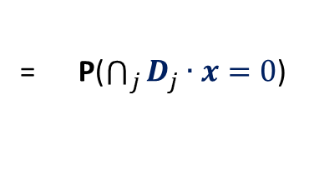

Frievald’s Algorithm (Analyzing error probability)
$$k$$
$P(D∙x=0$) depends upon $D$.
So what to do ☹ ?
Our goal is to get an upper bound on this probability.
So we start with the least information about $D$,
which is:
There is at least one non-zero element in $D$.
Let this element be $D_{i,k}^{}$.
P($D∙x=0$)
$≤$ P($D_{i}^{}∙x=0$)
➔ focus on the product of $i$th row and vector $x$.
$$1 2 … n$$
$$1$$
2
$$⋮$$
$$n$$
$$⨯$$
$$i$$
= P($\bigcap_{j}{D_{j}^{}∙x=0}$)
$$D$$
$$x$$
What is the relation between the two ?

Slide 18


Frievald’s Algorithm (Analyzing error probability)
$$k$$
P($D_{i}^{}∙x=0$) = P($D_{i1}^{}$ $∙x_{1}$ + … + $D_{in}^{}$ $∙x_{n}$ = 0)
The underlying sample space has $2^{n}$ elementary events.
Convince yourself that it is indeed difficult to calculate this probability from standard tools which you know.
Here we shall use a simple but powerful probability tool…
$$1 2 … n$$
$$1$$
2
$$⋮$$
$$n$$
$$⨯$$
$$i$$
$$D$$
$$x$$

Slide 19







Probability tool: Partition of sample space
A set of events $A_{1}$,…, $A_{n}$defined over a probability space ($Ω$,P) is said to induce a partition of $Ω$ if
$\bigcup_{l=1}^{n}{A_{l}}$ = $Ω$
$A_{i}\bigcap{A_{j}}$ =∅ for all$i≠j$
Theorem: (Partition theorem)
Given an event $ε$, we can express P($ε$) in terms of a given partition as:
P($ε$) = $\sum_{l}{\text{P}\text{(}ε}∩A_{l}$)
= $\sum_{l}{\text{P}\text{(}ε}\text{|}A_{l}$)∙ $\text{P}\text{(}A_{l}\text{)}$ using conditional probability
$$A_{2}$$
$$A_{3}$$
$$A_{4}$$
$$ε$$
$$A_{5}$$
$$A_{1}$$
Ω
$$A_{6}$$

Slide 20
Question: When to use the Partition theorem ?
Let be $ε$an event defined over a probability space ($Ω$,P).
Suppose it turns out that it is not easy to calculate or get a good bound on P($ε$) directly using the standard tools. In such situation, one may explore the following possibility:
Try to design a partition {$A_{1}$,…, $A_{n}$} of the sample space such that $\text{P}\text{(}ε|A_{l}$) is easy to calculate. This may be used to calculate $\text{P}\text{(}ε$).
IMPORTANT: Most of the times, $\text{P}\text{(}ε|A_{l}$) turns out to be independent of $l$. In this case, $\text{P}\text{(}ε$) can be bounded directly as follows.
If $\text{P}\text{(}ε$|$A_{l}$) $≤α$ for every possible value of $l$, then
P($ε$) = $\sum_{l}{\text{P}\text{(}ε}\text{|}A_{l}$)∙ $\text{P}\text{(}A_{l}\text{)}$
$≤\sum_{l}{α}$∙ $\text{P}\text{(}A_{l}\text{)}$
$=α\sum_{l}{\text{P}\text{(}A_{l}\text{) }}$
$=α$

Slide 21


Frievald’s Algorithm (Analyzing error probability)
$$ε$$
P( $D_{i1}^{}$ $∙x_{1}$ + … + $D_{in}^{}$ $∙x_{n}$ = 0 ) = ??
Question:
What can be the suitable partition of $Ω$?
➔ the partition defined by the values taken by all the r.v.’s excluding $x_{k}$.
…
Think over it carefully ?

Slide 22

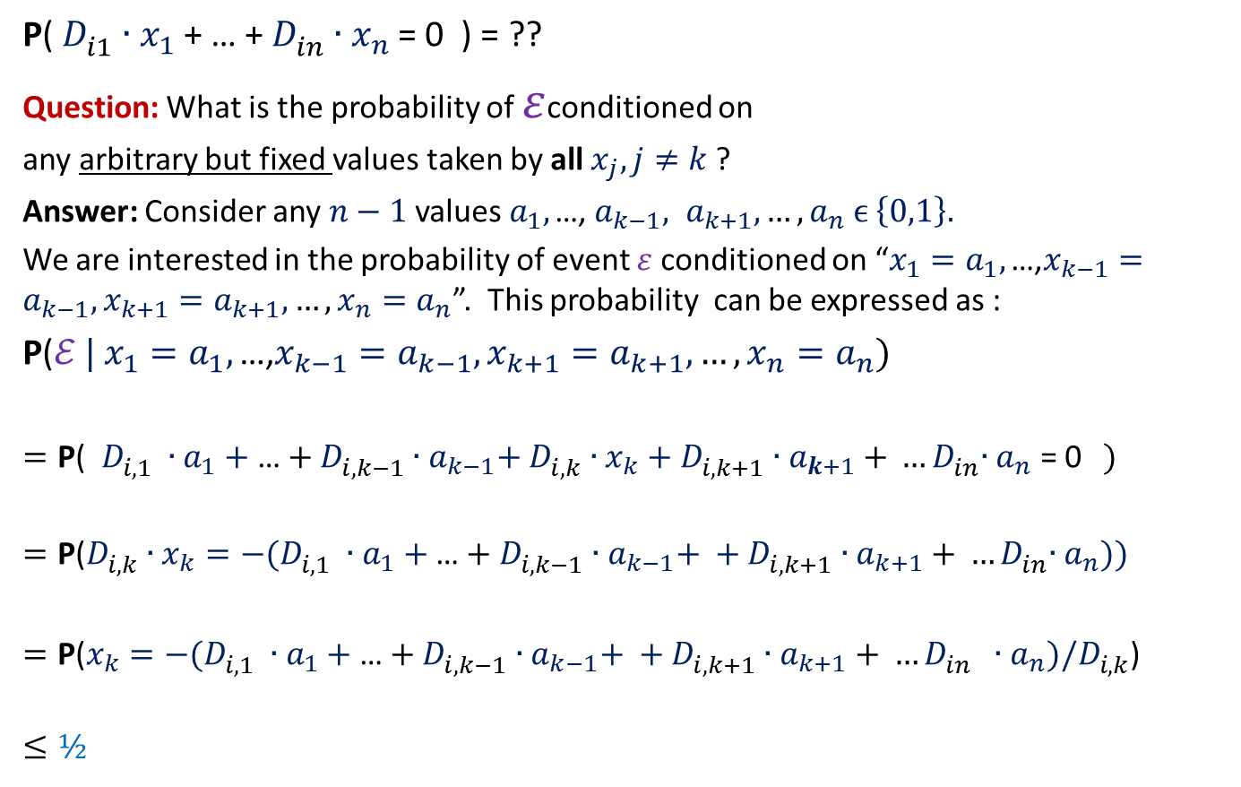

Frievald’s Algorithm (Analyzing error probability)
$$ε$$
P( $D_{i1}^{}$ $∙x_{1}$ + … + $D_{in}^{}$ $∙x_{n}$ = 0 ) = ??
Question: What is the probability of $ε$conditioned on
any arbitrary but fixed values taken by all $x_{j}, j≠k$ ?
Answer: Consider any $n−1$ values $a_{1}, \text{…,} { a}_{k−1}, a_{k+1}, …,a_{n} ϵ \left\{0,1\right\}.$
We are interested in the probability of event $ε$conditioned on “$x_{1}=a_{1}, \text{…,}x_{k−1}=a_{k−1},x_{k+1}=a_{k+1}, …,{x_{n}=a}_{n}$”. This probability can be expressed as :
$\text{P}\text{(}ℰ | x_{1}=a_{1}, \text{…}\text{,}x_{k−1}=a_{k−1},x_{k+1}=a_{k+1}, …,{x_{n}=a}_{n}$)
$=\text{P}\text{(} D_{i,1}^{} ∙a_{1}+\text{…}+D_{i,k−1}^{}∙a_{k−1}\text{+ }D_{i,k}^{}∙x_{k}+D_{i,k+1}^{}∙a_{k+1}{+ …D}_{in}^{}∙a_{n}\text{ = 0}$ )
$$=\text{P}\text{(}D_{i,k}^{}∙x_{k}=−(D_{i,1}^{} ∙a_{1}+\text{…}+D_{i,k−1}^{}∙a_{k−1}\text{+ }+D_{i,k+1}^{}∙a_{k+1}{+ …D}_{in}^{}∙a_{n}\text{)}\text{)}$$
$=\text{P}\text{(}x_{k}=−(D_{i,1}^{} ∙a_{1}+\text{…}+D_{i,k−1}^{}∙a_{k−1}\text{+ }+D_{i,k+1}^{}∙a_{k+1}{+ …D}_{in}^{} ∙a_{n}\text{)/}D_{i,k}^{}$)
$$≤½$$
$≤½$
≠0
Could be 0, 1 or some other number

Slide 23
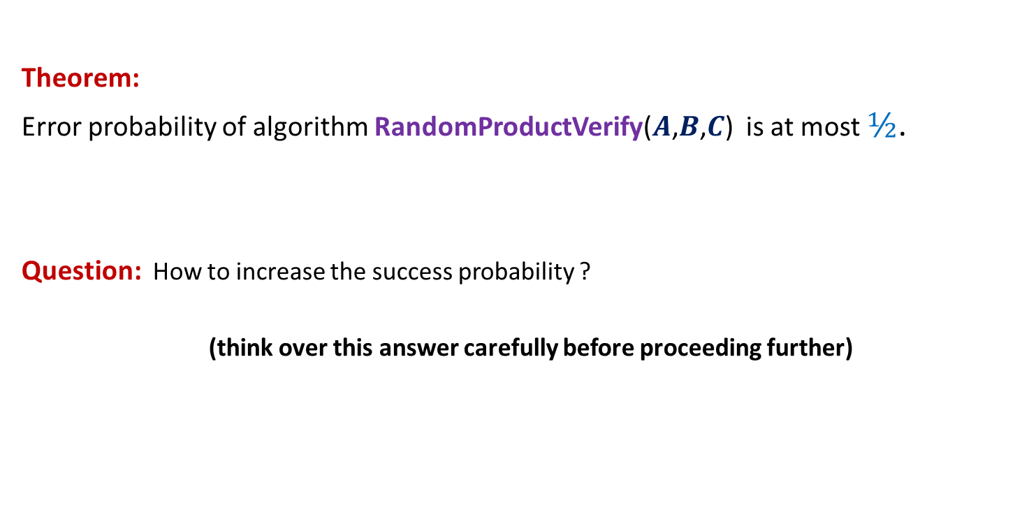
Frievald’s Algorithm (Analyzing error probability)
Theorem:
Error probability of algorithm RandomProductVerify($A$,$B$,$C$) is at most $½$.
Question: How to increase the success probability ?
(think over this answer carefully before proceeding further)

Slide 24

Frievald’s Algorithm (Analyzing error probability)
Theorem:
Error probability of algorithm RandomProductVerify($A$,$B$,$C$) is at most $½$.
Question: How to increase the success probability ?

Slide 25
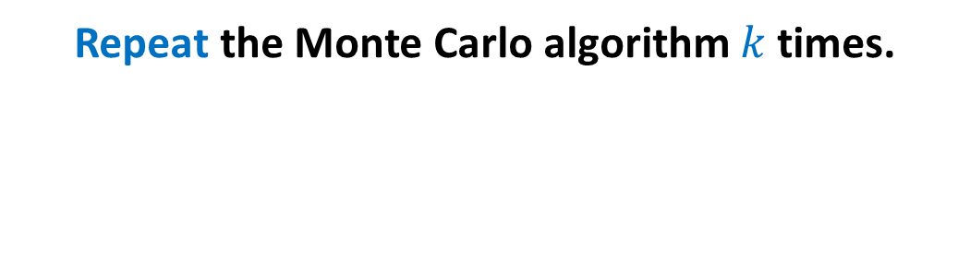
Probability Ampilification
Repeat the Monte Carlo algorithm $k$ times.

Slide 26
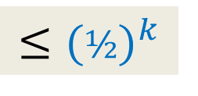
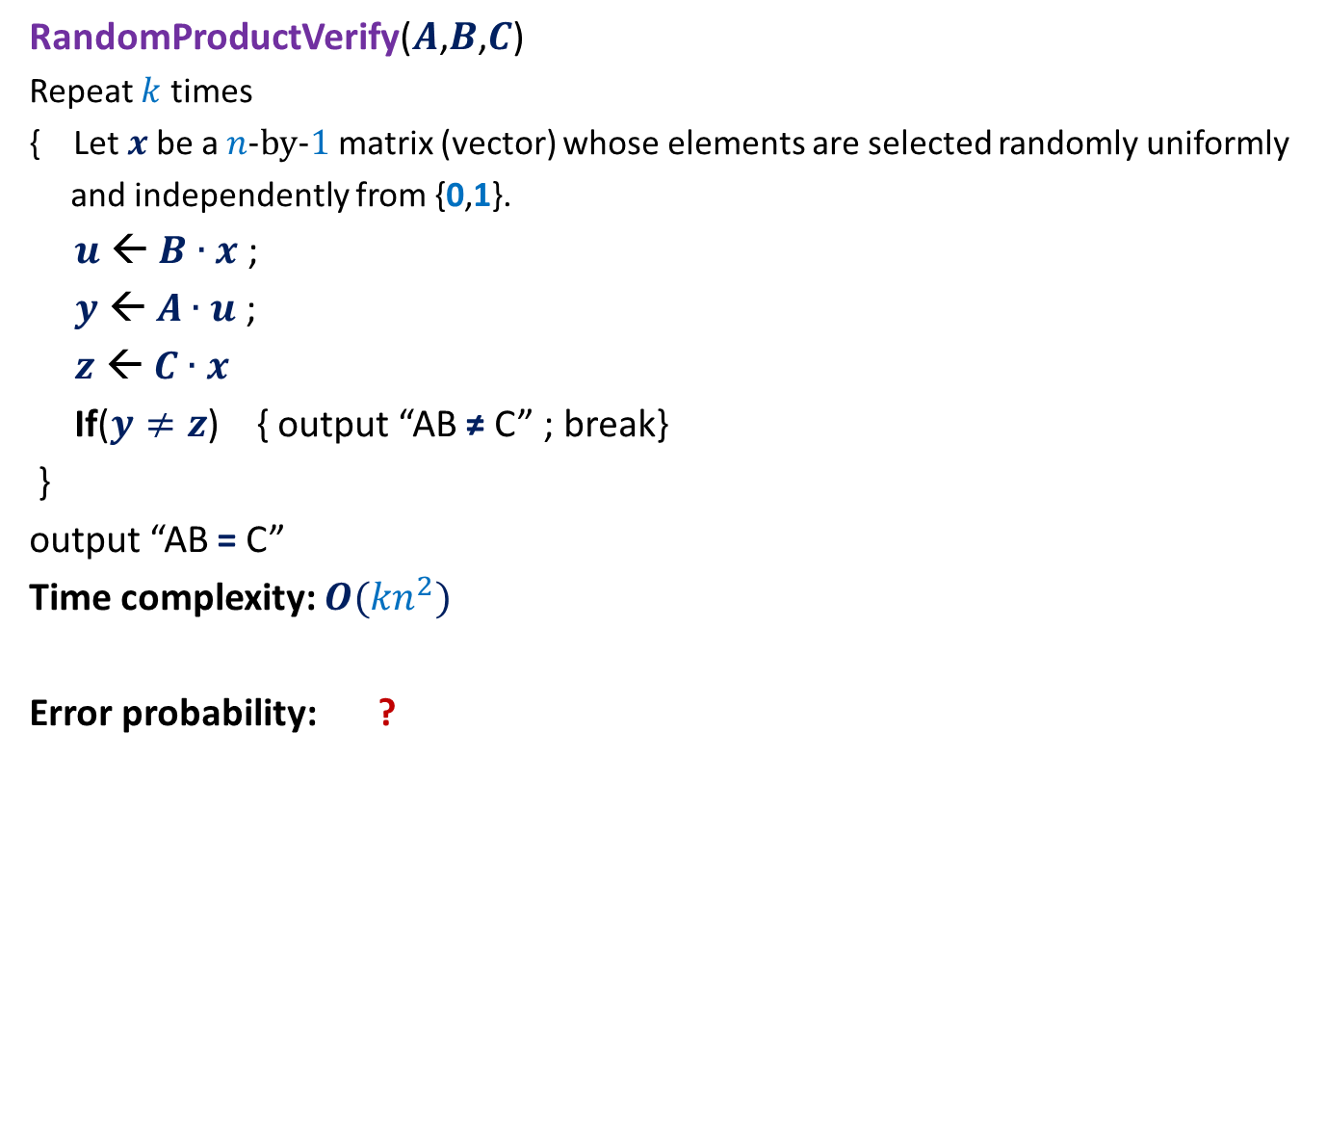
Frievald’s Algorithm (reducing the error probability)
RandomProductVerify($A$,$B$,$C$)
Repeat $k$ times
{ Let $x$be a $n$-by-$1$matrix (vector) whose elements are selected randomly uniformly
and independently from {0,1}.
$u$ ← $B∙x$ ;
$y$ ← $A∙u$ ;
$z$ ← $C∙x$
If($y≠z$) { output “AB ≠ C” ; break}
}
output “AB = C”
Time complexity: $O({kn}^{2})$
Error probability: ?
$$≤{(½)}^{k}$$

Slide 27

Frievald’s Algorithm (final result)
Theorem: Given three $n$-by-$n$matrices $A$, $B$, and $C$,
there is a Randomized Monte Carlo algorithm which determines $C≟A⨯B$.
The running time is $O(n^{2}log n)$, and the error probability is less than $n^{−2}$.

Slide 28

Homework
Is there anything magical about $½$ in the error probability ?
What is the source of $½$ in the error probability ?

Slide 29
Please go through the slides of this lecture carefully and patiently.
You are welcome to discuss any doubt in the next class (Monday, 13th August)

Slide 30
Fun with probability

Slide 31

With the inspiration from RandApproxMedian algoritm
Design
An extremely simple
randomized LasVegas algorithm with
expected O($n$) running time
for exact median.

